Slide 1



Disease Diagnosis Using Machine Learning
( DiagnoseMe )
supervised By D.Inad Al-Jarah
DiagnoseMe

Slide 2

TEAM
Amal Qazaq
Ahmad Drabkah
Abd Alnaser Alshare Osama Shatat

Slide 3

Introduction
DiagnoseMe
Our web application, designed with a goal to make people life easier by making the diagnosis process faster, easier, more elegant and modern.

Slide 4
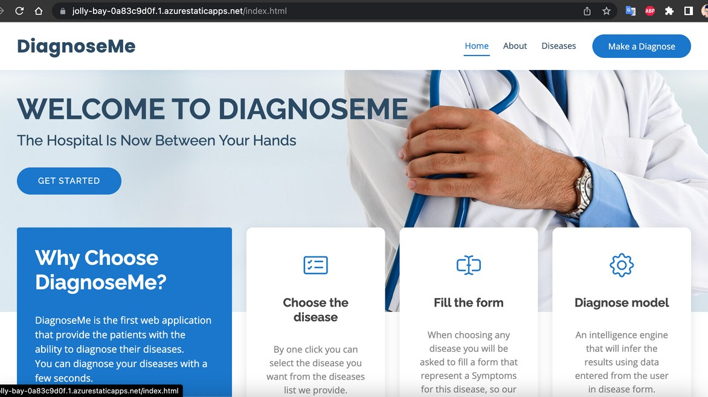
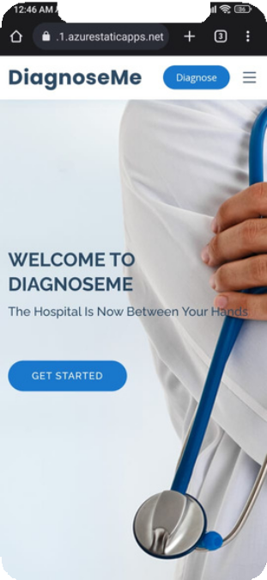
User Friendly ON PC or Mobile
The application User Interface (UI) is designed to be used by any patient from any gender and any age.
You can access the website by typing diagnoseme.team in google

Slide 5
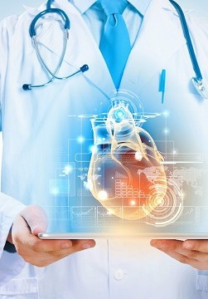
Privacy and Security
Our application is secure and save user privacy as there is no any kind of data storing for medical or personal information.
DiagnoseMe

Slide 6

" Taught humanity what they knew not."
Holly Quran-96-5
Application Using
The application is developed to be used on any mobile or computer as long as it has a web browser.
The application is used as a platform for patients to get their diagnosis by navigating through our provided list of illnesses that they think or may have.
The patients fill the diagnose form and get the result.

Slide 7

Software Design
Our software contains three main parts: ML models.
Web application. User interface (UI).
Each part has been developed and implemented independently of the others parts using a programing language.
let's start with Software Design

Slide 8
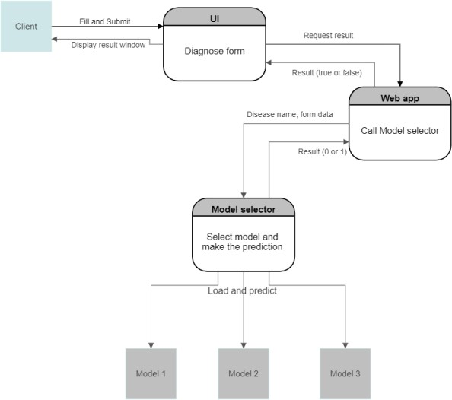
Data Flow Diagram

Slide 9
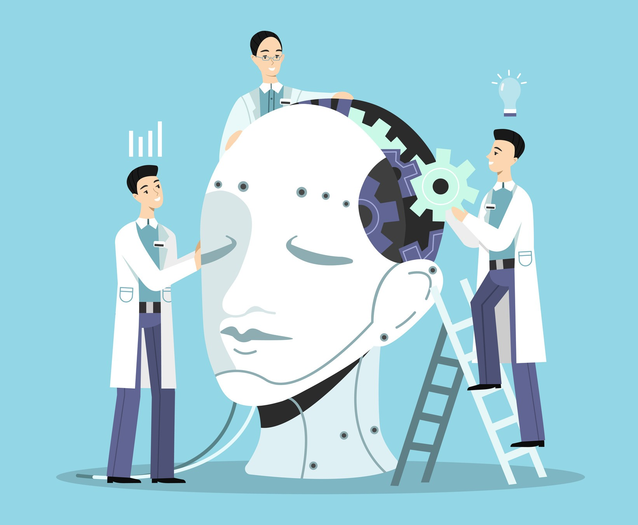



In our application there is three models each one for a disease COVID-19, Diabetes and Heart stroke.
All models implementation are the same only differ in the preprocessing step. As each dataset has its properties and values.
ML models
In the next slides we will explain COVID-19 model implementation as example.

Slide 10

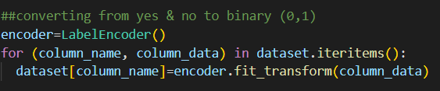
COVID-19 model
The dataset consist of 5435 rows and 22 columns with values of "YES" and "NO".
First preprocessing step is convert values from words into number.

Slide 11

This preprocessing step is very important and applied on all datasets
This step is helped in select the best and the most effect in the target value .
After we chick the plot we drop the feature with bad correlation.
Correlation Plot

Slide 12

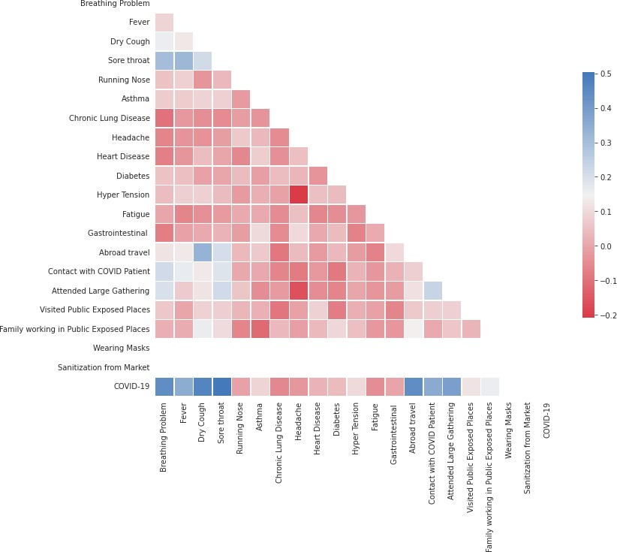
Correlation Plot

Slide 13
This preprocessing step needed when the dataset not balance.
Not balance mean the number of classes (0 or 1) in the target feature isn't equal.
Data Sampling
This step is implemented for all models as usually diseases datasets are not balance.

Slide 14
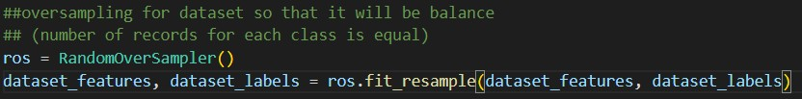
In our models we use random over sampling (it take random rows from minor class and duplicate it until it equal to major class)
Data Sampling

Slide 15
Now after finishing preprocessing we split dataset into training and validation dataset.
Validation dataset used after train the model to check its accuracy, precision, recall, f1 score.
Dataset Spilte
We use sklearn library for this.

Slide 16
Now we will display each model architecture and its validation

Slide 17
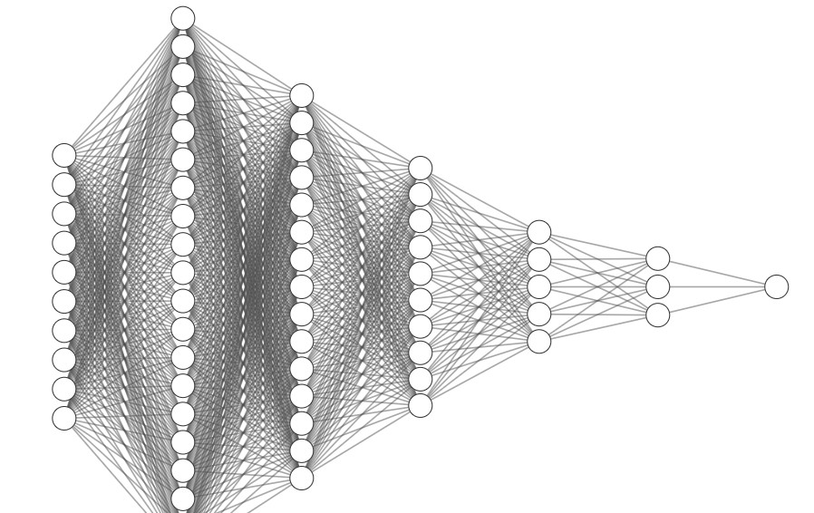
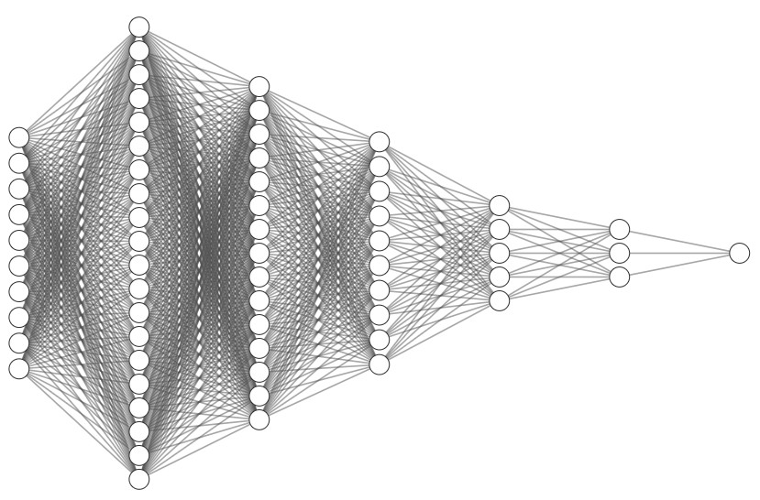
Input Layer
Hidden 1
Hidden 2
Hidden 3
Hidden 4
Hidden 4
Output Layer
Covid-19 Model

Slide 18
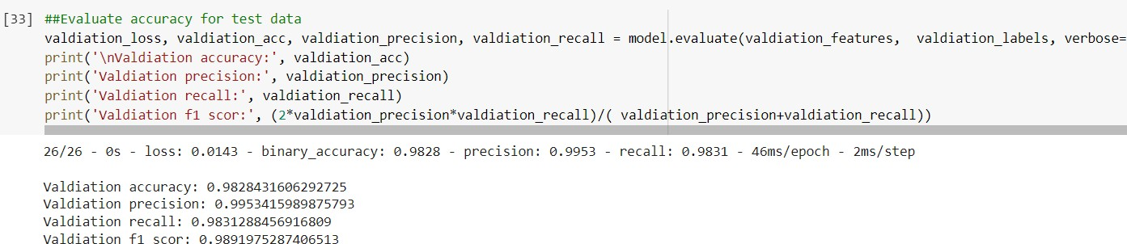
COVID-19

Slide 19
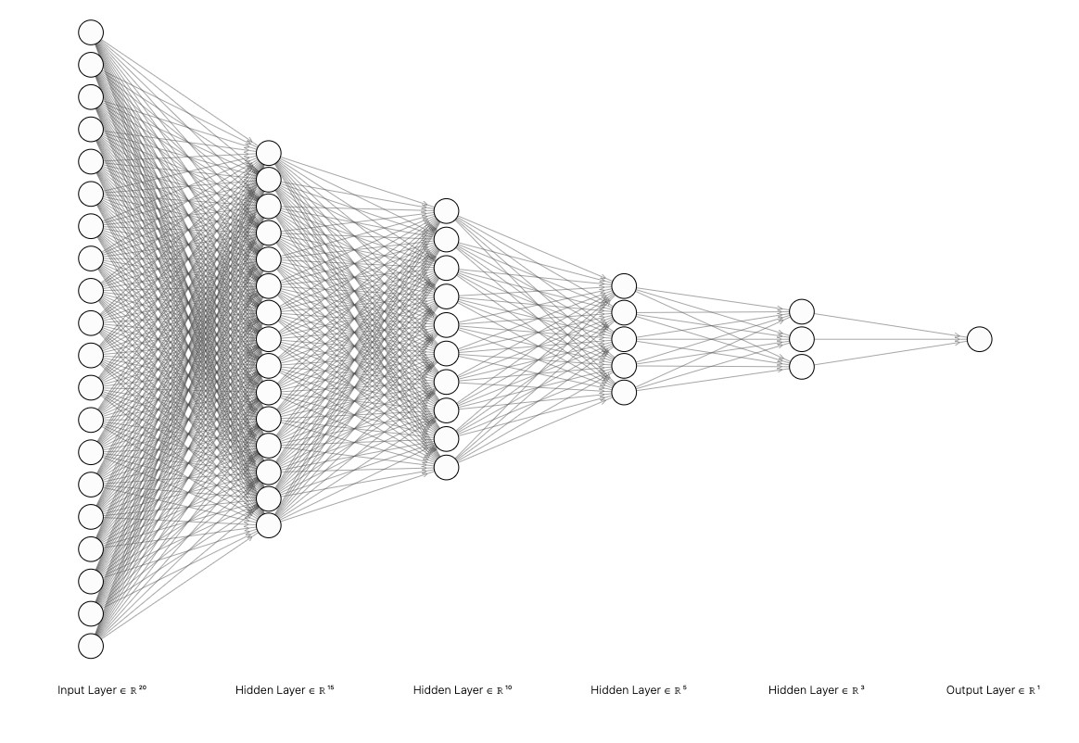
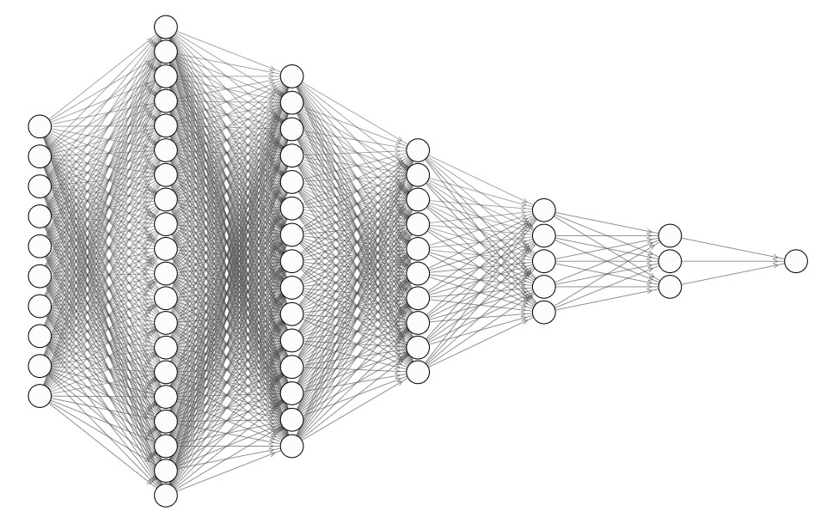
Input Layer Hidden 1 Hidden 2 Hidden 3 Hidden 4 Output Layer
Diabetes Model

Slide 20
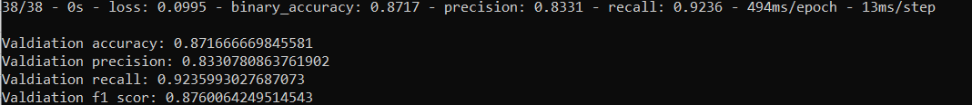
Diabetes

Slide 21
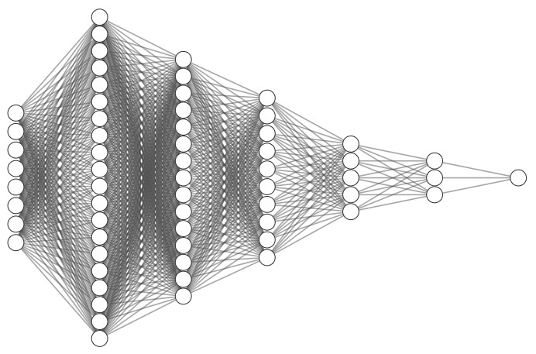
Input Layer Hidden 1 Hidden 2 Hidden 3 Hidden 4 Output Layer
Heart Stroke Model

Slide 22
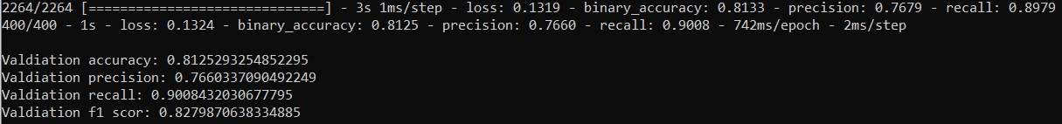
Heart stroke

Slide 23

After completing all the previous steps no we will save our model.
Model Save
We saved all model as .h5 file so it will be load and use by the model loader .

Slide 24

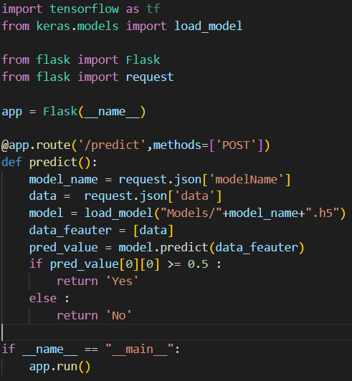
Model Loader
This part is responsible to implement a RestAPI to be an interface between web app and models
This application is implement using Flask framework as web app send a HTTP request with post method the request most contain the model name (disease to be diagnosed) and data input by the user.
It used the data from request to load the model and predict the result, then return "YES" if predict value grater than or equal 0.5 otherwise it will return "NO".

Slide 25

Web Application
This part is developed using Spring Boot (Framework in Java).
This part will take the data from UI and pass it for the model loader and get back the result.
let's start with Web Development

Slide 26
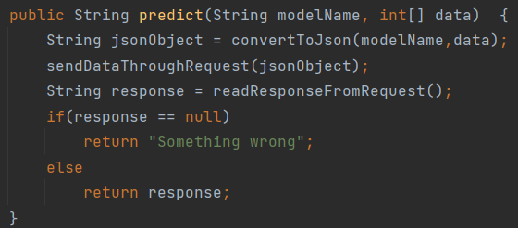
Predictor Class
This class is responsible to connect with the model loader (RestAPI) to send the data that come from the UI.
The main method in this calss is predict method which receive the data and convert it to JSON Object then send it through the request and read the response.
Web Application

Slide 27
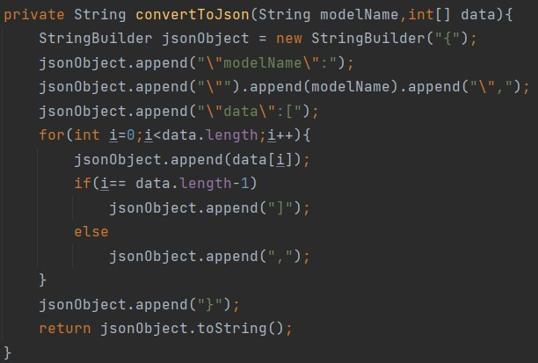
Predictor Class
The method convertToJson take the model name (model which will used in the diagnose) and data as array of integers and convert it to JSON Object
JSON Object : it is a set of string keys and values pairs like {"name":"Ahmad",...}.
Web Application

Slide 28
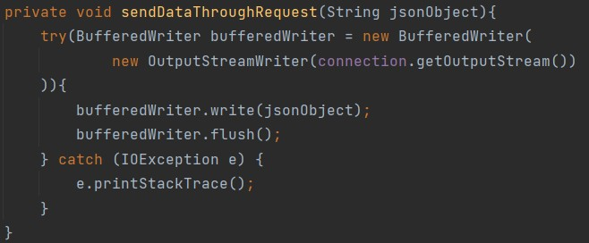
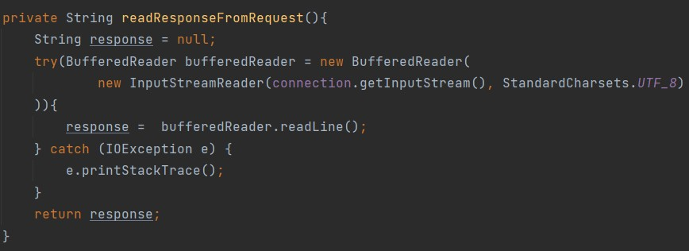
Predictor Class
send data through request
Web Application
read data from the request

Slide 29
Controllers
This is the entry point of the application that implement a RestAPI that is used by the UI
Web Application
We have a controller for each model (disease) in the system.
Each controller has a makePredict method which represent the RestAPI of POST method to receive the data from the UI as object in the request body.

Slide 30
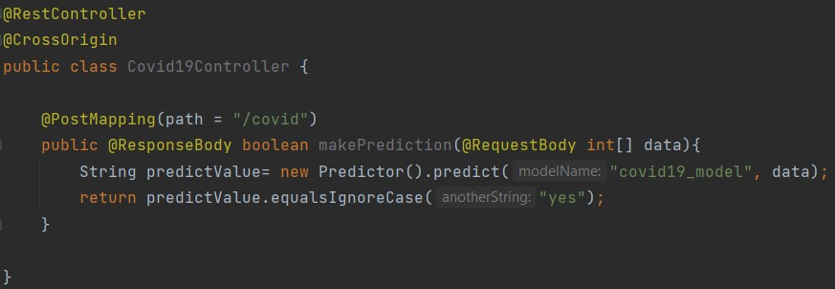
Controllers
Each makePridect method in each controller has mapping path with the disease it diagnose.
This method use predict calss to get the diagnose result.
Web Application

Slide 31

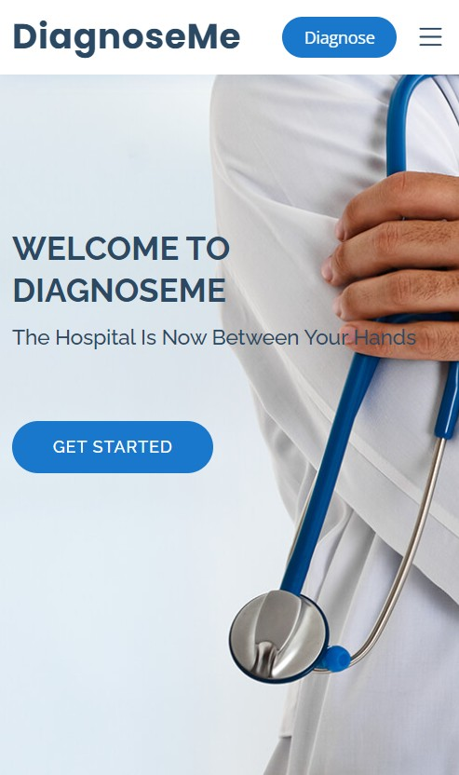
User Interface (UI)
For this part please open the website while we discuss the implementation
You can access the website by typing diagnoseme.team in google

Slide 32


This is the last part of our software, it is the part that the client's use and interact with.
This part is implemented using HTML, CSS and JavaScript.
The website entry point is the home page from which you can navigate to About and Diseases pages.
Diseases page contain the diseases which you can select, then it will navigate you to the diagnose form.
User Interface (UI)

Slide 33

The important part in UI is the apiHandler which is a script of JavaScript.
This script is used to send a request from UI with diagnose data from UI to the web application.
It send the request to the Web application RestAPI using Ajax.
User Interface (UI)

Slide 34

API Handler
I will display the implementation in the VS code text editor
User Interface (UI)

Slide 35
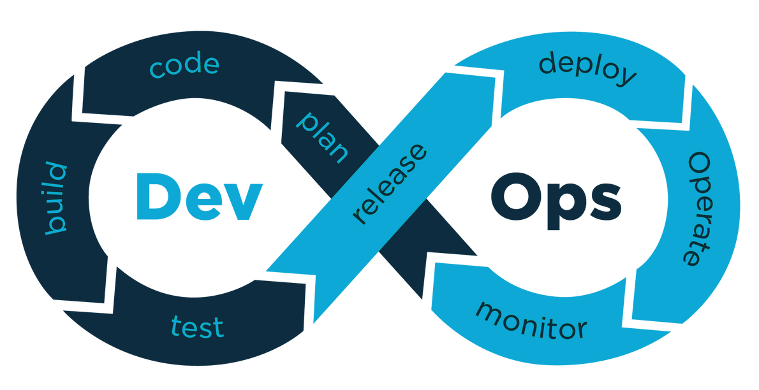
Deployment
This phase of development to make the application available to be accessed online.
This phase done using GitHub and Microsoft Azure in all steps.

Slide 36


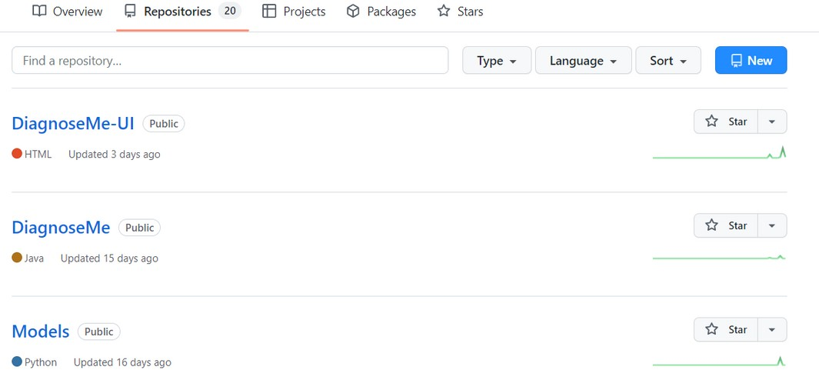
It is the most popular version control system, so we use in our development process.
We submitted each of three part on individual repository to make the merging of the code easier.
Deployment

Slide 37
Also we use GitHub Actions to implement CI\CD pipeline.
CI\CD pipeline useing to automate the deployment operation.
CI\CD pipeline implemented by writing workflow script (Will see next).
Deployment
The pipeline automatically will redeploy the app to Azure service when any change push to repository.

Slide 38
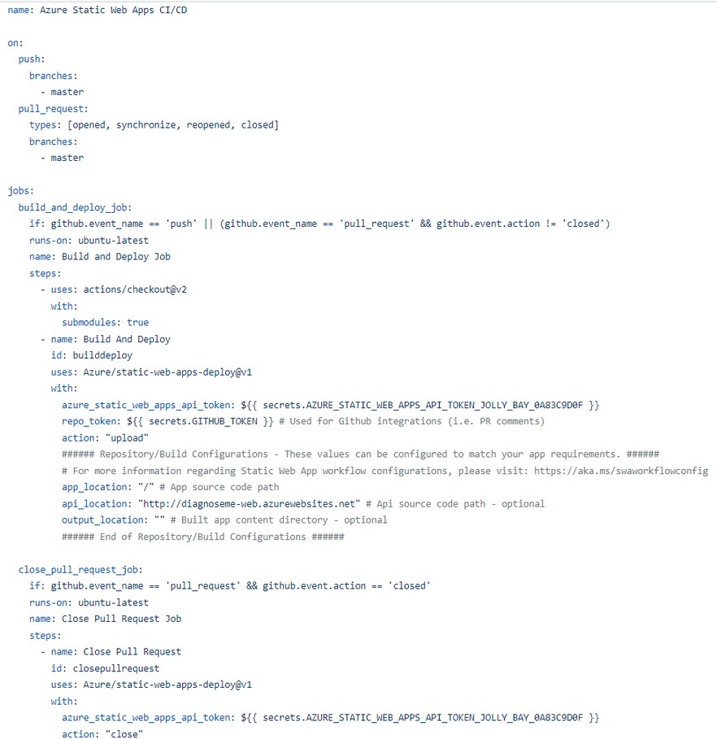
For each repository we wrote workflow to deploy it.
Deployment

Slide 39

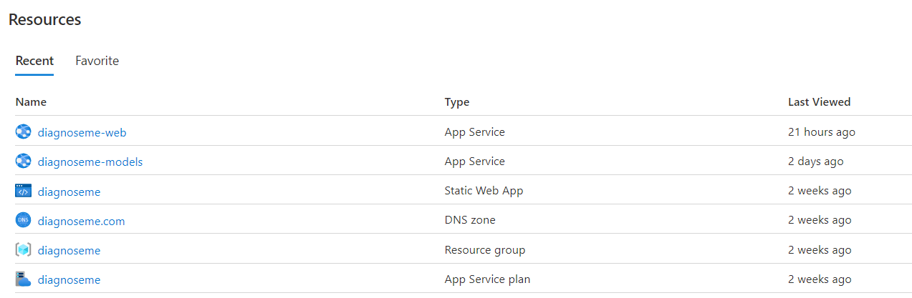
We use Azure platform to deploy our application .
We deployed each part of the application into individual Azure Service.
Microsoft Azure
Each Azure Service is a web server connect with it using HTTP protocol .
Deployment

Slide 40

Domain Name
When deploying an Azure service give a random domain name (URL), so for the UI part as our website is we want the URL to be easy to memorize.
We solve this problem by get a domain name from Name.com site.
Deployment
We authenticated and connected the domain name with Azure Service using CNAME and ANAME validation.

Slide 41
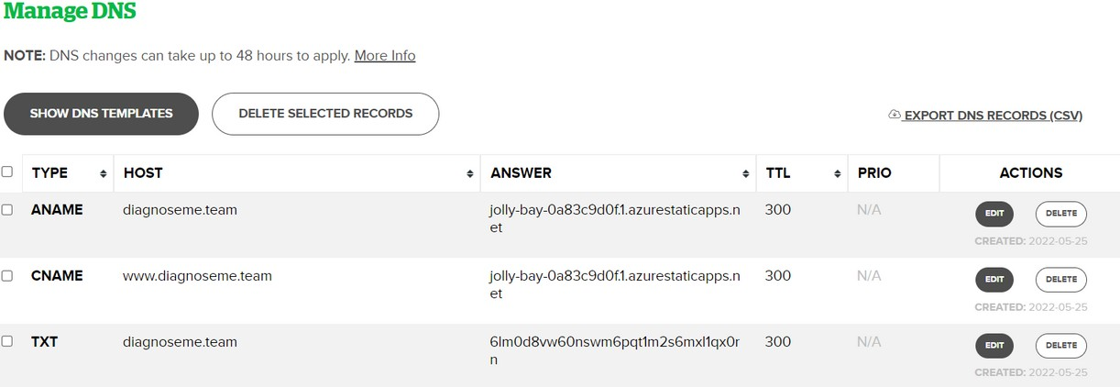
Domain Name
Deployment

Slide 42

Thanks For Watching
The End
DiagnosMe

